Slide 1
AWS introduction

Slide 2
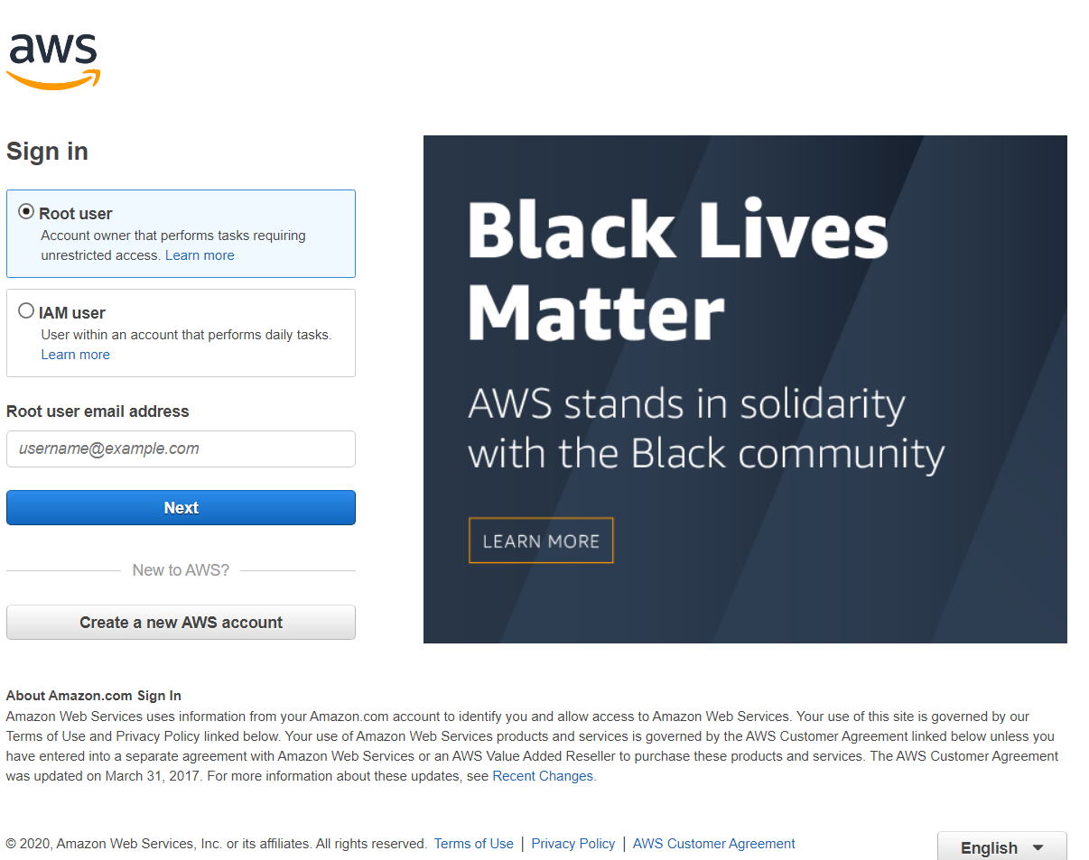
login
Visit the site
https://aws.amazon.com/console/
Enter an mail address
max@miprobes.de
press Next then enter password
MiProbes2019!

Slide 3
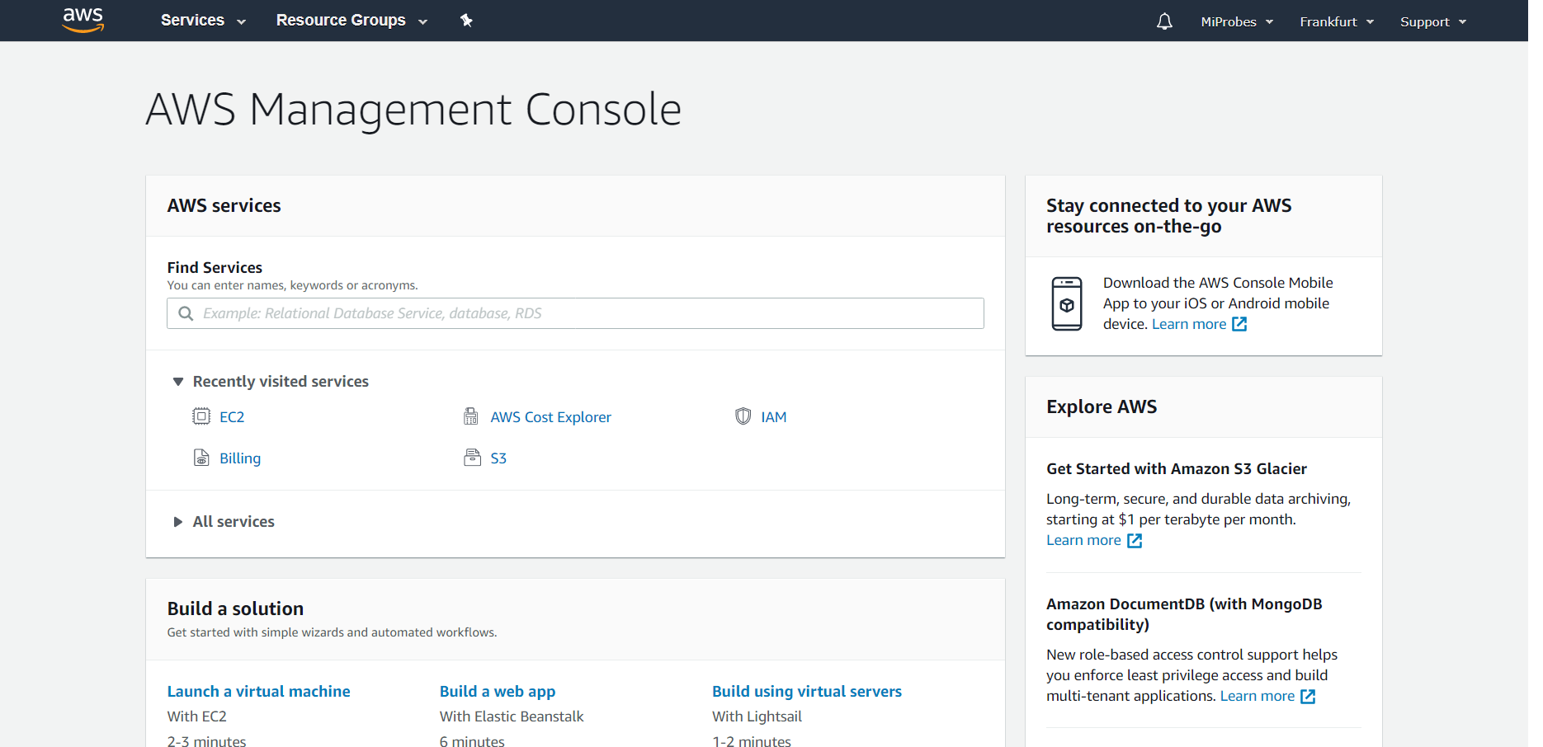
Home page - Instances
Click
services
EC2
Running instances

Slide 4
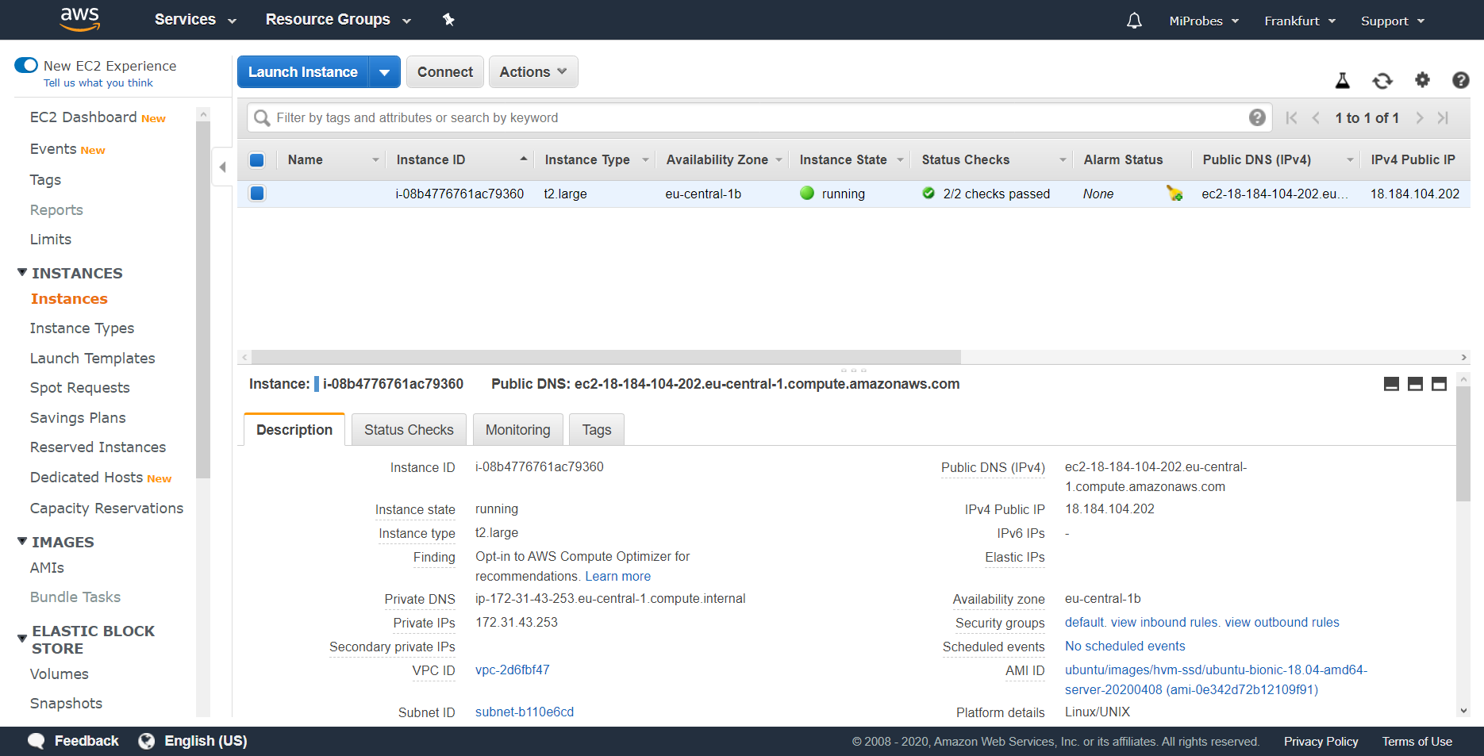
Instance page
View all running and stopped instances / VMs
Get the public IP for connecting via ssh or flask webpage

Slide 5
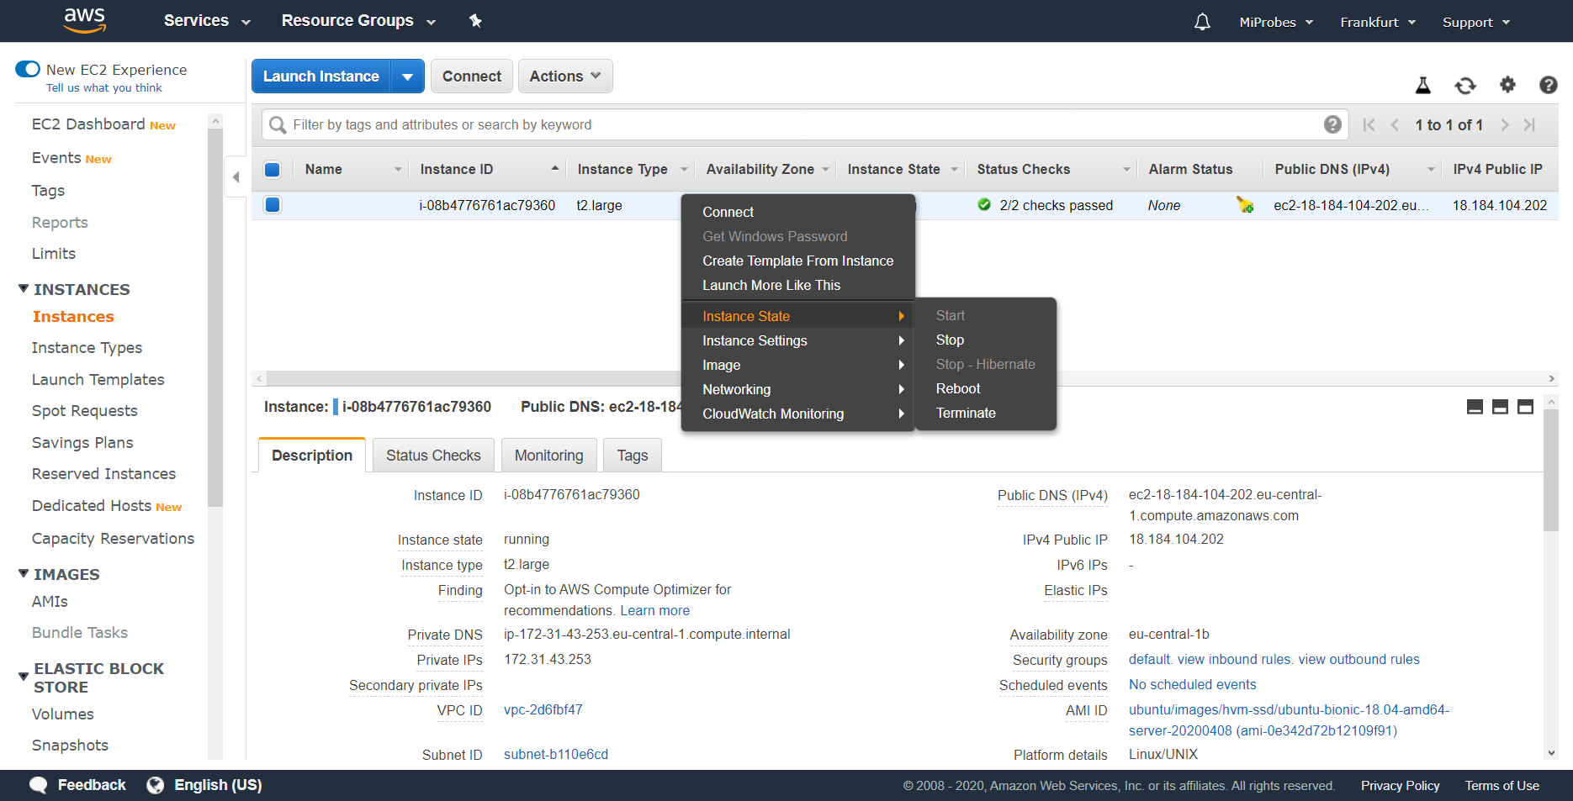
Instance page
Perform maintenance on an instance by right-clicking then going to Instance State
Equivalent to a physical PC
Start – Pressing Power On
Stop – Pressing Power Off
Reboot – Pressing Restart
Terminate – Dropping the PC in the ocean

Slide 6
Home page - Billing
Click
MiProbes
My Billing Dashboard

Slide 7
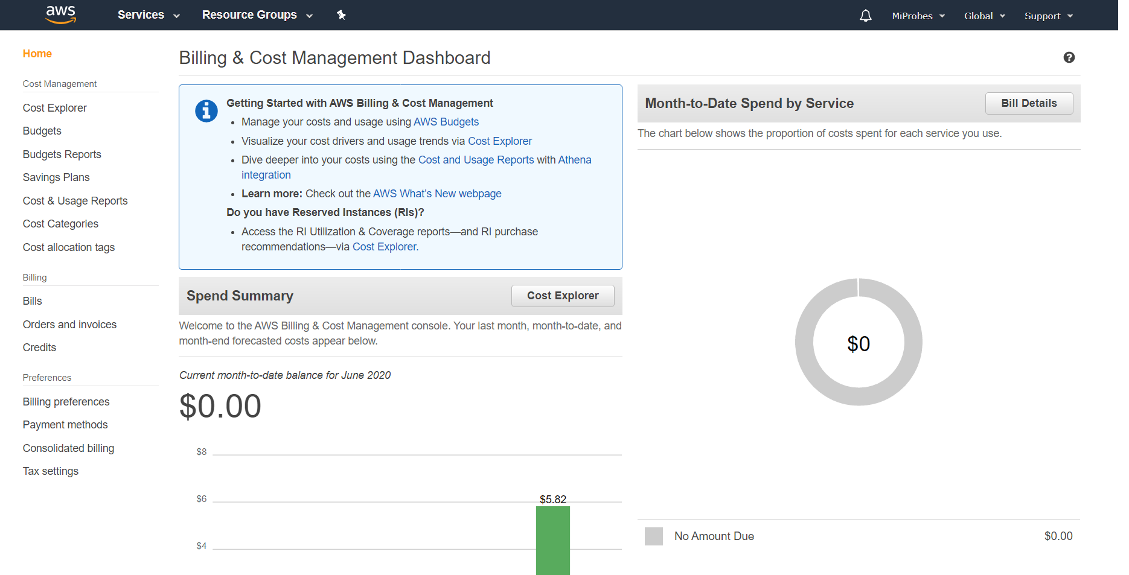
Billing dashboard – cost explorer
Click
Cost Explorer
Launch Cost Explorer

Slide 8
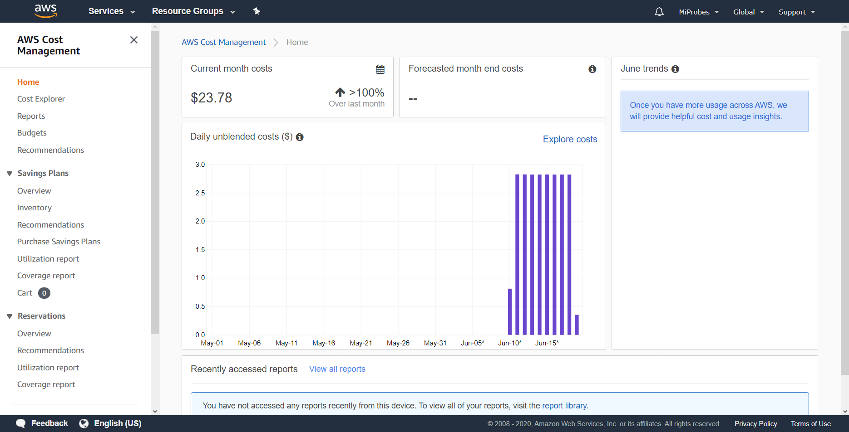
Cost Explorer
View monthly costs in top left section
Hover over columns in graph to see daily expenses
View detailed expenses by clicking
Explore Costs

Slide 9
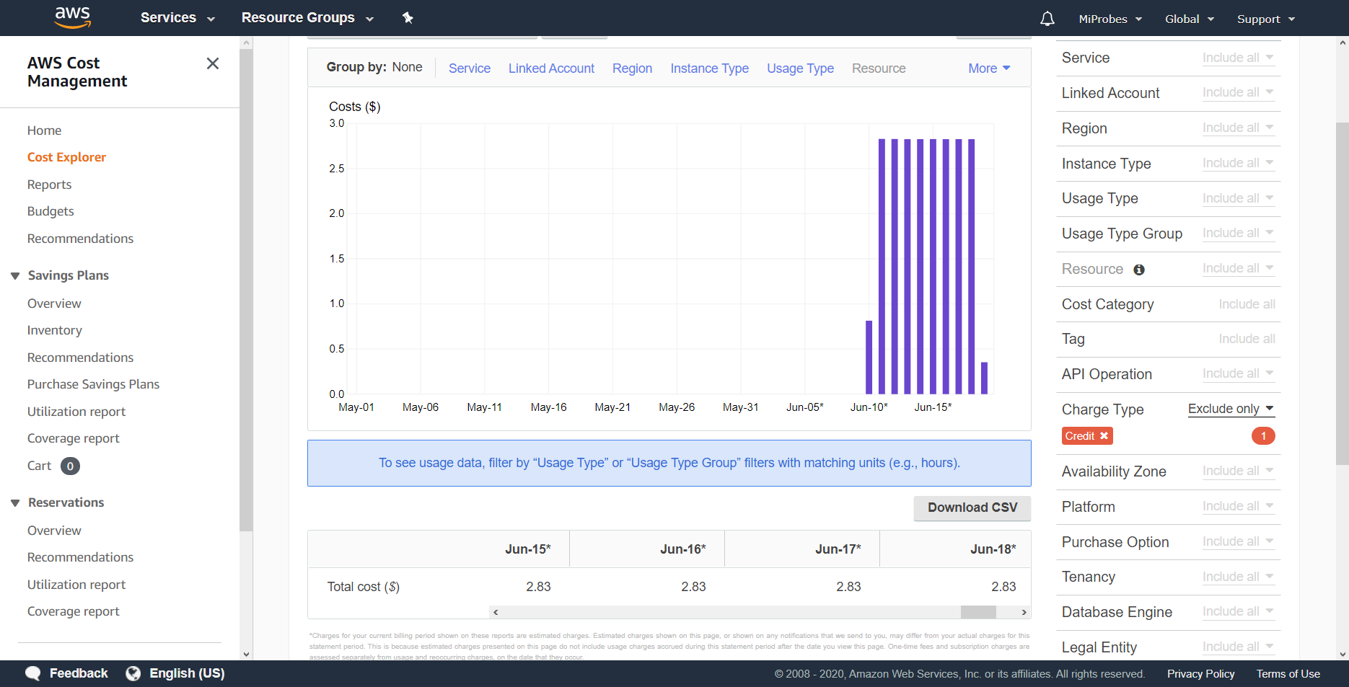
Cost Explorer – in depth
View downloaded files detailing expenses

Slide 10
Billing dashboard – remaining credits
Click
Credits

Slide 11
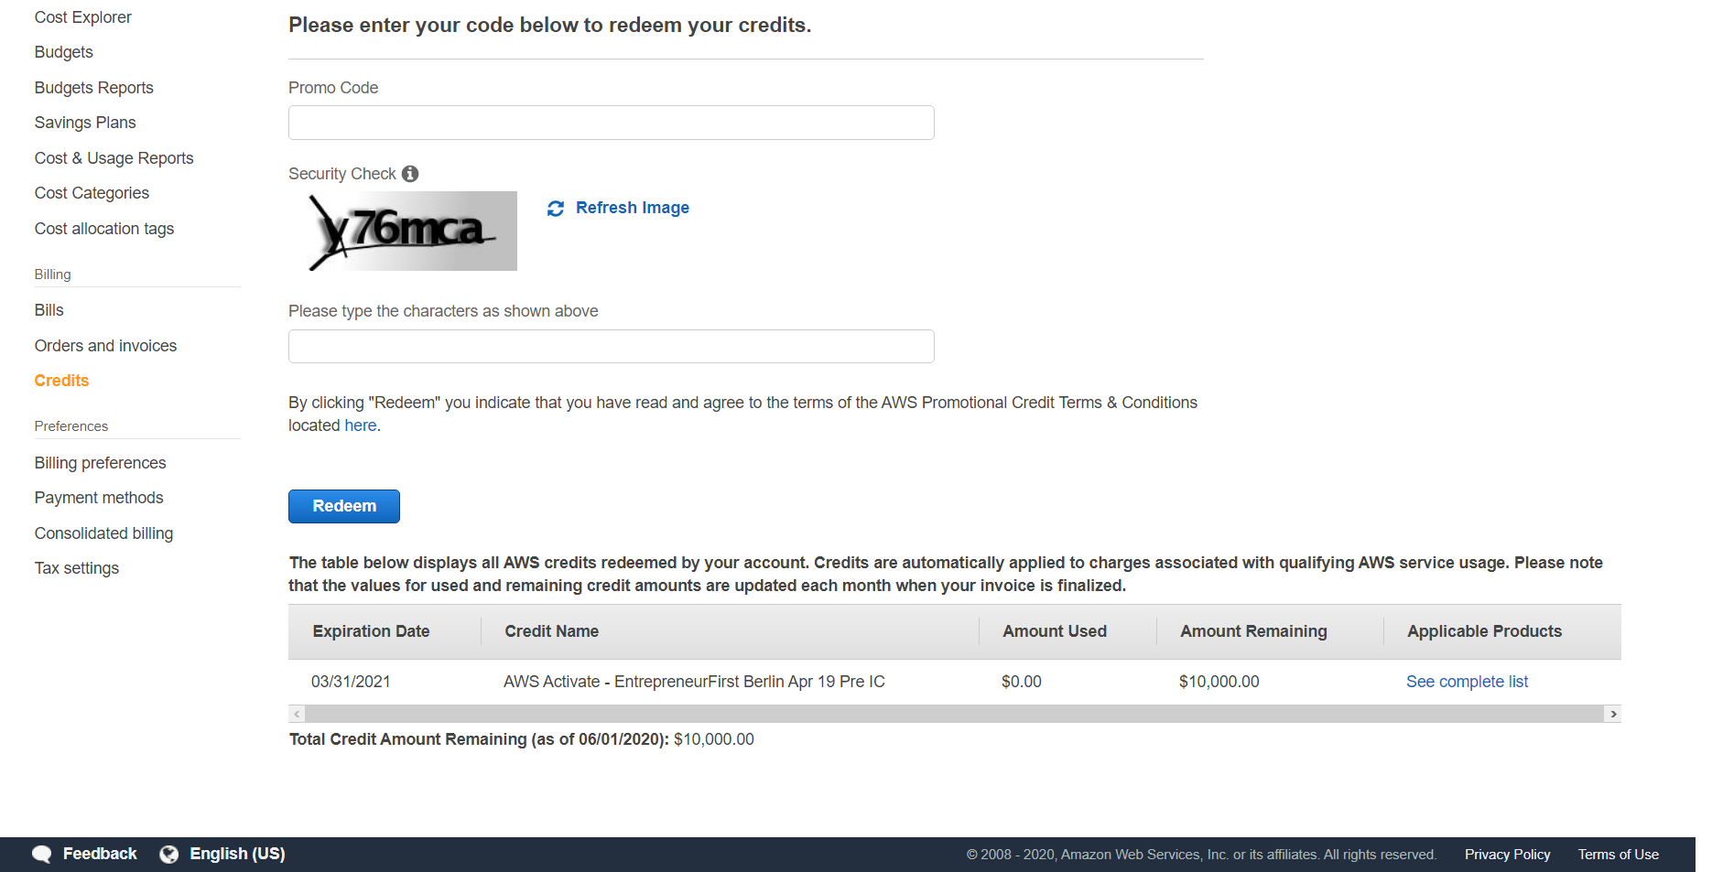
Credits
View remaining credits on this page
Likely updates monthly

Slide 12
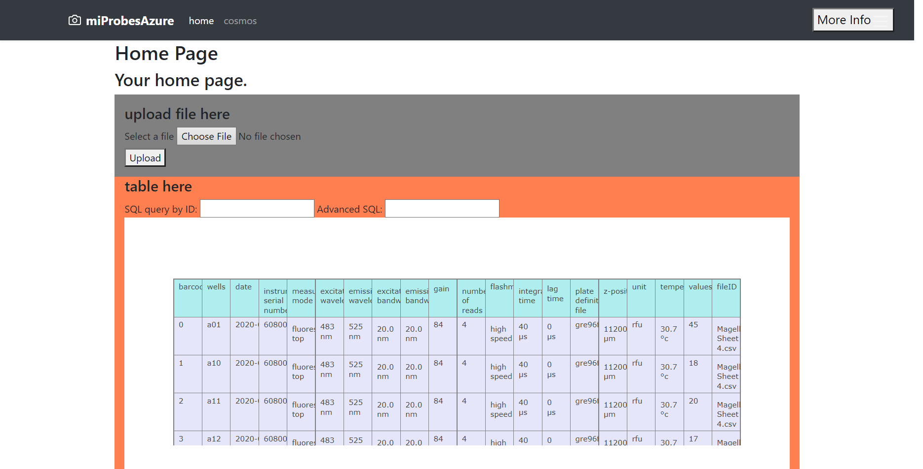
Webpage
http://18.184.104.202:5000 or
http://18.184.104.202:5000/upload_page
IP:Port
IP is from the public IPv4 viewed on the instance page
Port for flask web page is 5000

Slide 13
Webpage
Upload a file
Click ‘choose a file’, then click upload
This will upload the raw file to S3, format the file into a dataframe, upsert it into the sqlite database, then call the db to present a table to view
Below it will then generate a heatmap of the uploaded file

Slide 14
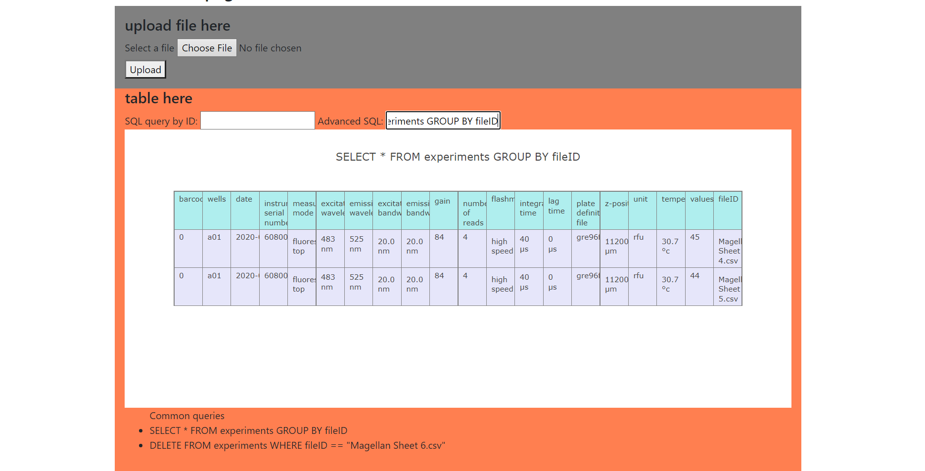
Webpage
Advanced query
Type a sqlite3 query into the Advanced SQL input
Press enter
This will execute the query against the db
Then display the resulting dataframe
Some common queries are at the bottom (can format into buttons or a drop-down menu if desired)
As removing files from the db should be uncommon, currently implemented through sql query

